Slide 2
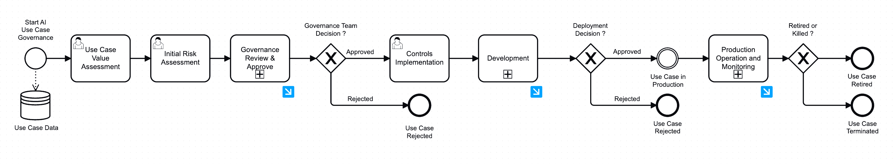
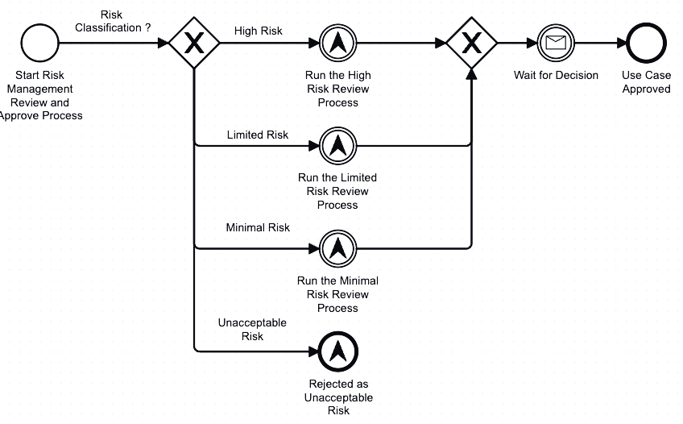
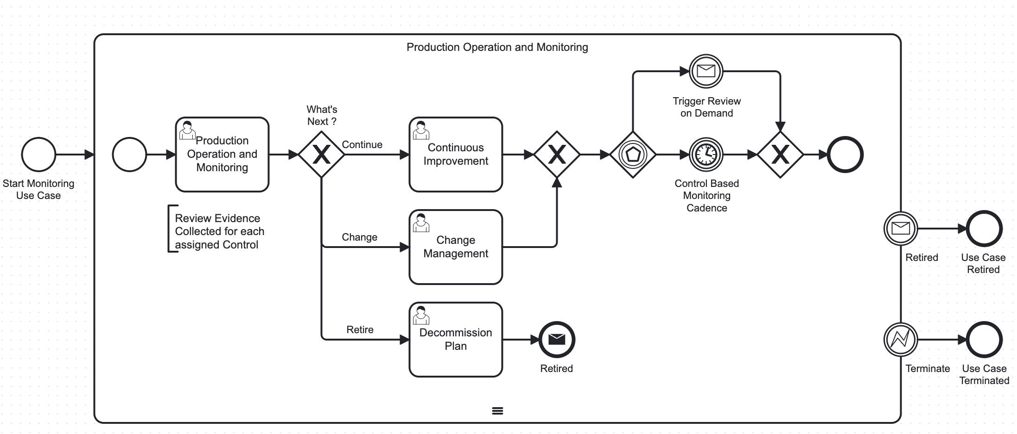
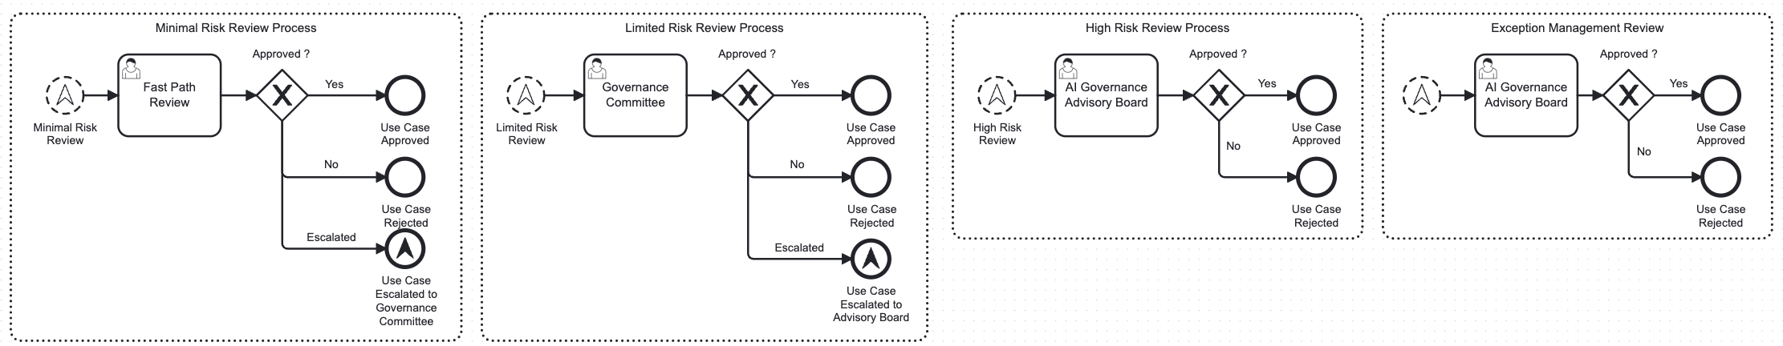
End-to-end Transparent AI governance program All processes and sub-processes are fully defined with RACI role definitions driving alignment across the organization and extended stakeholder teams.
Integrated and Transparent AI Governance Operating Model (current thought process)
SDLC
Risk Assessment Best Practice
Observability and Monitoring Best Practice

